Slide 1
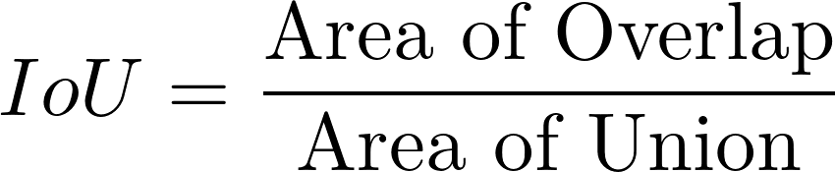
Previous Work
time
Encode
Stream
Decode
Infer
Stream
Render
Glimpse, each key frame is sent to the server and the server return objects in the frame

Slide 2
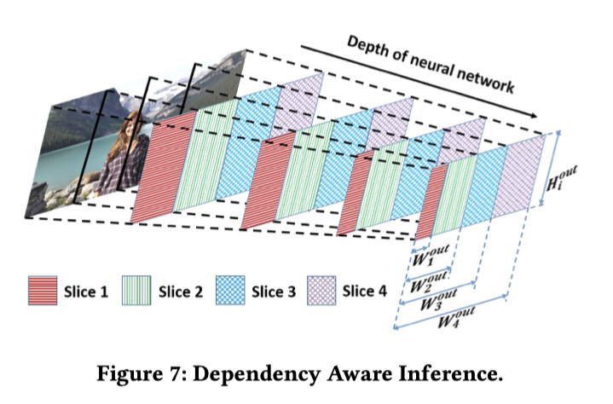
Mobicom'19 Parallel Streaming and Inference
time
Encode
Stream
Decode
Infer
Stream
Render
S
D
I
Reduced Time
S
D
I
S
D
I
由于encoding过程的Motion Vector要参与决策是否要上传帧，因此encoding实际上并没有参与流水
Inference阶段，对先到的Slice块计算神经网络的部分结果来加速如右图
服务器端的加速

Slide 3
Mobicom'19 Parallel Streaming and Inference
I帧
P帧
P帧
P帧
P帧
P帧
P帧
P帧
P帧
P帧
P帧
红色为需要上传到服务器的帧，蓝色为没有上传服务器的帧
第一个帧先传到服务器，后面所有的帧都要以该帧作为参考帧来计算P帧，计算P帧的同时可以得到Motion Vector用于预测没有上传的帧的边框位置，和光流法类似
当服务器返回第i帧的预测结果后，后面的帧都以第i帧作为参考帧进行编码，因为只有上传的帧才会作为参考帧，所以上传到服务器的视频能够正确解码

Slide 4
Our Method
Encode
Stream
Decode
Infer
Stream
Render
E
S
D
I
S
基于Object重要性进行优先视频编码，先对可能包含检测目标的部分进行编码，传输和检测
服务器端至少可以通过多块GPU并行达到互不影响
E
S
D
I
S
E
S
D
I
S
···
S
D
I
S

Slide 5
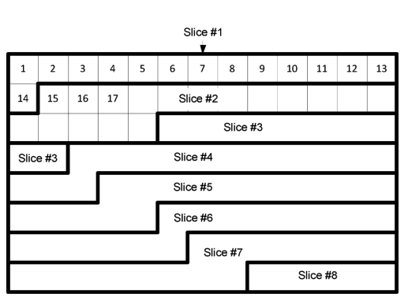
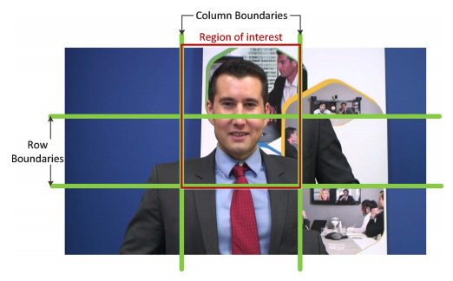

Our Method
H 264中每一帧被分成不同的Slice，Slice之间是独立编码的，由于slice只要是基于网络端考量而设计的，所以Slice是按照扫描线的顺序划分的
HEVC 相比于H264 增加了Tile的划分方法，可以将视频帧划分为不同的矩形
首先将视频划分为MxN的格子，根据上一帧的结果预测当前帧的目标被哪些格子覆盖，对每一个格子设置编码的优先级
Slice
Tile
浅蓝色的Tile为优先编码和传输的部分

Slide 6
Related Works
R-CNN
- R-CNN 首先使用selective search 获取regions
- 对每一个区域算feature map，然后用svm做分类，对每一个区域做回归修正
Fast-RCNN
只算一遍feature map,然后对regions做region pooling，然后分支成两个网络分别做分类和回归修正
Faster-RCNN
- 将selective search 换成RPN网络，RPN网络的输入是图片的feature map

Slide 7
Related Works
The Power of Tiling for Small Object Detection，将图片分成tile后进行train和infer CVPRW 2019

Slide 8
Our Method
Mobicom'19使用Motion Vector来预测下一个帧的目标的位置，寻找一个精度更高的方法
我们的方法大大增加了服务器端的计算任务，寻找优化的方法

Slide 9
解码模块显存
视频信息 | 单视频解码 |  | 多路解码成JPEG
 | fps | 显存占用 | 25 | 30
sample_720p.mp4 分辨率：1280x720 长度：00:00:48 大小：15.6 MB | 893-769 | 145MiB | 33-38(cpu:51.3%) | 25-32(cpu:45.3%)
掠食城市.mp4 分辨率：1920x1080 长度：00:00:48 大小：16.4 MB | 380-213 | 199MiB | 20-25(cpu:51.4%) | 11-16(cpu:45.1%)
显卡：GeForce GTX 1070 显存：8119MiB 处理器：Intel® Core™ i7-8750H CPU @ 2.20GHz × 12 内存：15.5 GiB
一路720P视频占约145MB显存

Slide 10
Deep Learning模块显存
模型先要分配1.2G的显存，然后batch_size每增加1,增加250MB显存

Slide 11
两种架构
架构一：解码和检测在同一台机器上
架构二：解码和检测在不同的机器上
 | 架构一 | 架构二
视频路数 | 如果batch_size=路数，那么能够解码27路 如果batch_size=8,则可以解码60路 | 12GB能解码80路视频
延迟 | 延迟低 | 延迟高（图片编码，图片解码，网络传输）
所需带宽 | 无 | 一张图片70KB，那么80路视频为80x70xfr=5.6xfrMB带宽
数据流复杂性 | 低 | 高
成本 | 取决于处理的帧率
架构二相较于架构一并没有足够的优势，同时图片编解码部分浪费了计算资源，增加了调度、同步、网络等方面的复杂度

Slide 12
Patch-level Real Time Object Detection for Mobile AR
AR and MR systems understand the physical scene by real-time object detection
Object detection on high resolution image is necessary
- Large View, Small Objects
- A straightforward down-sample will fail to detect small objects
High resolution video bring more latency, as well as low tracking accuracy
- more transmission latency
- more inference latency
Solution:
- to reduce transmission latency: h265 encoding, select patches to detect
- to reduce inference latency: parallel inference

Slide 13
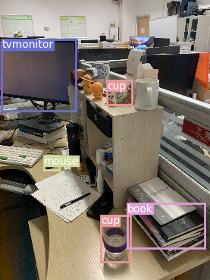
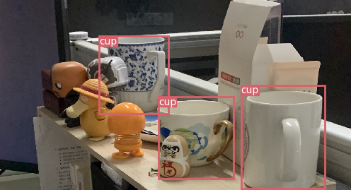
Patch-level Real Time Object Detection for Mobile AR

Slide 14
Patch-level Real Time Object Detection for Mobile AR
Encoding video to M x N tiles
Predict target patches by tracker, each patch has speed, scale parameters
If the frame is a I Frame, upload the whole frame by patches priority
If the frame is a P Frame, select patches to upload

Slide 16
Related Work
time
Encode
Stream
Decode
Infer
Stream
Render

Slide 17
Related Work
time
Encode
Stream
Decode
Infer
Stream
Render

Slide 18
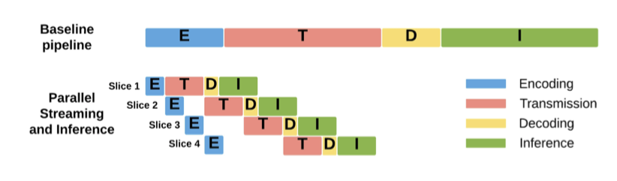
Related Work
Key Ideas:
Dynamic ROI Encoding 对ROI使用高质量编码，对非ROI区域进行低质量编码，ROI使用上一帧得到的区域进行稍微放大
Parallel Streaming and Inference 将视频帧从左到右切分成四块，提前推断神经网络部分值
Motion Vector Based Object Tracking 类似与光流法，但光流法是先有完整帧然后计算得到光流，Motion Vector是视频编码提取到的特征
Mobicom’19 Edge Assisted Real-time Object Detection for Mobile Augmented Reality

Slide 19
Our Proposal
Server
Video
Decoder
Video
Encoder
Video Stream

Slide 20
配色板

Slide 21
EdgeTile: Tile-based Real-Time Object Recognition on Edge Devices
Xu Wang

Slide 22
Background
New trend in edge computing
- improved hardware: AI chips, support HEVC encoding
- lightweight model: model compression
- deep learning models could run on mobile device or drone
Current Edge computing framework
- Glimpse, MobileAR

Slide 23
Problems
Deep learning models run on mobile device at the expense of precision, especially for small objects
Network latency plays important role in edge computing framework
Computing resources allocation among tasks (i.e. encoder, detector, tracker) on the device
- tracking time varies with the number of objects and object size

Slide 24
Solution
We propose a new framework for real-time object recognition
- a mobile detector to detect general objects
- a edge detector to detect small objects
- a mobile tracker for real-time tracking
a content-based priority offloading pipeline to reduce latency and small object detection
A dynamic tracking scheme, high fps for fast objects and low fps for slow objects

Slide 25
Contribution
The framework to offload complex object detection to edge
Content-based priority pipeline inference
Dynamic tracking scheme
Evaluation and implementation

Slide 26





Video Stream
Mobile Encoder
Edge Detector
Mobile Detector
Mobile Tracker

Slide 27

Video Stream
Mobile Encoder
I Frame
P Frame
P Frame
P Frame
P Frame
Edge Detector
Mobile Detector
Mobile Tracker

Slide 28
Video Stream
Mobile Encoder
I Frame
P Frame
P Frame
P Frame
P Frame
Edge Detector
Mobile Detector
Mobile Tracker

Slide 29

Video Stream
Mobile Encoder
I Frame
P Frame
P Frame
P Frame
P Frame
Edge Detector
Mobile Detector
Mobile Tracker
Priority Video Transmission

Slide 30
Video Stream
Mobile Encoder
I Frame
P Frame
P Frame
P Frame
P Frame
Edge Detector
Pipeline / Small Object Detection
Mobile Detector
Mobile Tracker

Slide 31















Video Stream
Mobile Encoder
I Frame
P Frame
P Frame
P Frame
P Frame
Edge Detector
Pipeline / Small Object Detection
Mobile Detector
General Object Detection
Mobile Tracker

Slide 32
Video Stream
Mobile Encoder
I Frame
P Frame
P Frame
P Frame
P Frame
Edge Detector
Pipeline / Small Object Detection
Mobile Detector
General Object Detection
Mobile Tracker
Edge Bboxes
Mobile Bboxes
Refer Frames

Slide 33
Video Stream
Mobile Encoder
I Frame
P Frame
P Frame
P Frame
P Frame
Edge Detector
Pipeline / Small Object Detection
Mobile Detector
General Object Detection
Mobile Tracker
Fast Objects
High fps
Edge Bboxes
Mobile Bboxes
Slow Objects
Low fps
Refer Frames

Slide 34





